Slide 1
Modeling Gun Violence Using the CDC’s Social Vulnerability Index
Adam Sam

Slide 2


Introduction
This project aims to train a model predicting U.S gun homicide rates using demographic factors represented by the CDC’s Social Vulnerability Index (SVI) dataset
Applying machine learning techniques can offer an unbiased understanding of gun violence and help provide meaningful solutions

Slide 3

What is SVI?
Social Vulnerability Index (SVI) is an index developed by the CDC
It’s intended to quantify a community's vulnerability towards disasters (hurricanes, floods, etc.)
Because of its feature-rich dataset encompassing many demographic factors, it has potential outside of its intended use

Slide 4
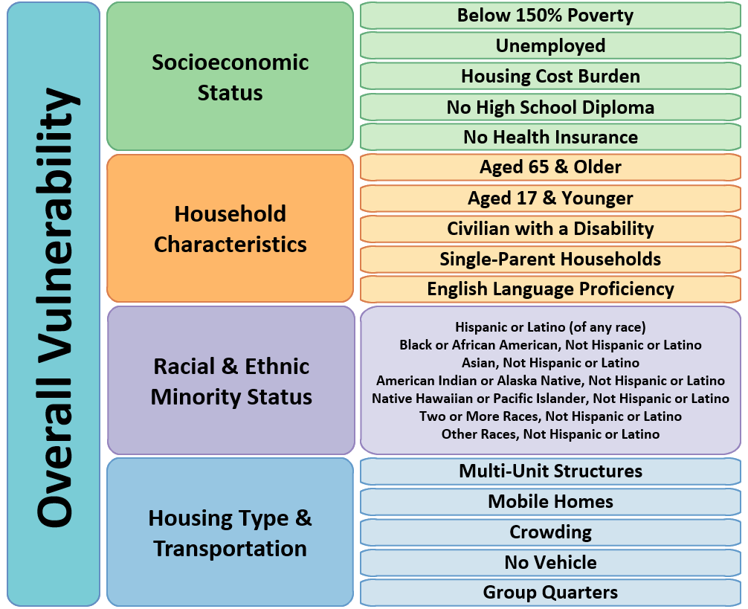
Dataset
Calculated Scores Features
SVI dataset consists of four vulnerability scores related to four themes, along with an overall vulnerability score
Within the four themes are demographic features that determine its vulnerability score
Gun homicide data also comes from the CDC, measured in 100k deaths per capita
All data from 2022 will be analyzed

Slide 5
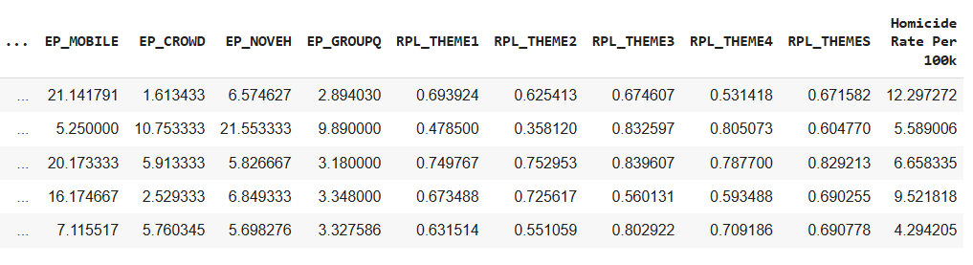
Dataset Excerpt - Rows represent U.S states
Overall vulnerability score
Indicating features
Thematic vulnerability scores
Target

Slide 6
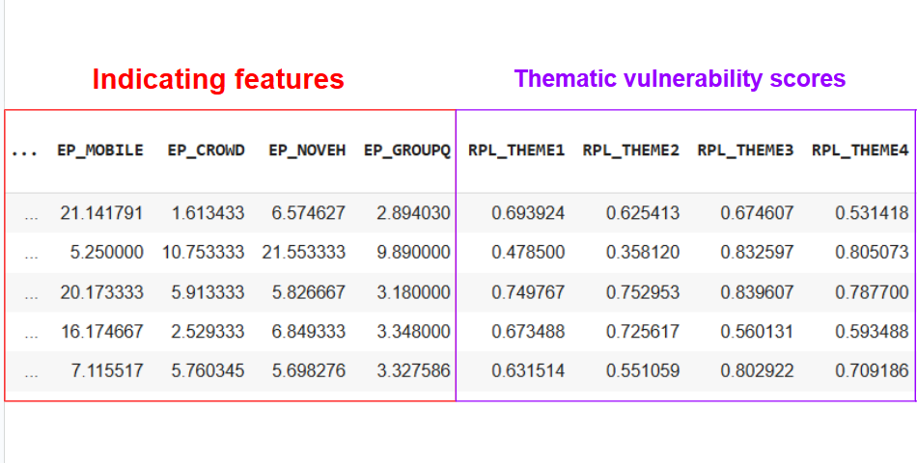
Dataset Preprocessing
Irrelevant columns were dropped from the dataset (state abbreviations, county codes etc.)
Raw values of population were dropped, keeping only the percentages
County-level SVI data was grouped by states, and values were aggregated using averaging
Because of multicollinearity, I removed the vulnerability scores from the data
Thematic scores are calculated by the indicating features, which introduces multicollinearity

Slide 7
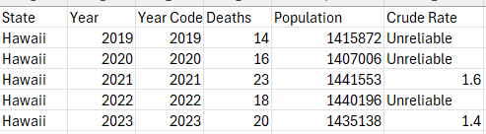
Dataset Preprocessing
For gun-homicide data, CDC reports values where the total amount of deaths < 20 as “Unreliable”. These values were restored using manual calculation
The final dataset consists of 51 samples, and 16 features

Slide 8
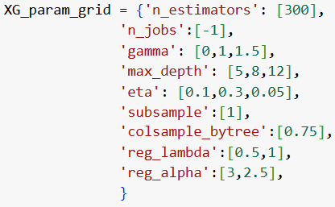
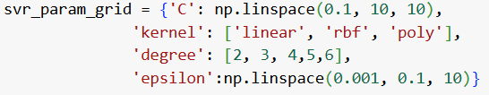
Establishing a Baseline
Chosen models:
Linear Regression
Support Vector Regression
XGBoost Regressor
SVR and XGBoost hyperparameters were optimized using GridSearchCV. For consistency, the same parameter grids established in the baseline are used for the remaining experiments.

Slide 9
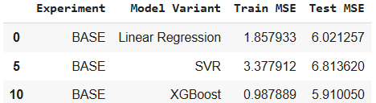
EXPERIMENT: BASELINE
XGBoost performed the best, though at a small margin ahead of linear regression
SVR performed the worst, with the highest test errors
SVR CV chose a polynomial kernel with a degree of five, which may indicate overfitting

Slide 10
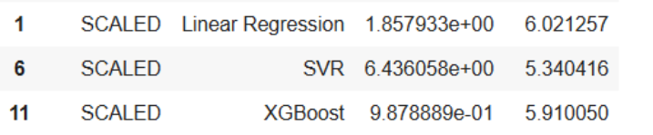
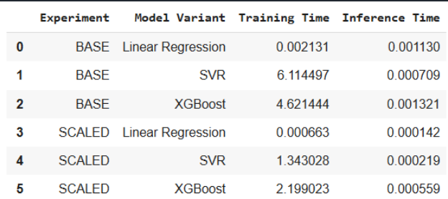
EXPERIMENT: SCALED
Features were scaled using MixMaxScaler()
Scaling improved training times significantly
MSEs remained the same, except for SVR
SVR CV chose a linear kernel - this reduced overfitting and led to better test errors
To save time, all other experiments will use scaled data

Slide 11
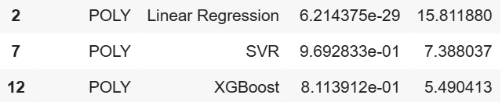
EXPERIMENT: POLYNOMIAL FEATURES (DEGREE 2)
Polynomial features were generated using SciKit’s PolynomialFeatures() function - increasing the feature count to 152 features
Linear regression performed much worse than baseline, severely overfitting the data
SVR also performed worse than baseline, but was more resistant to overfitting than linear regression
This indicates SVR’s ability to handle high-dimensional data through its regularization technique
DEGREE = 2

Slide 12
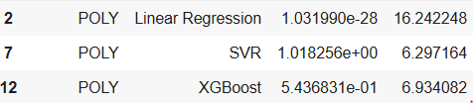
EXPERIMENT: POLYNOMIAL FEATURES (DEGREE 3)
Third degree polynomials worsened XGBoost performance (more overfitting) but slightly improved SVR performance (less overfitting)
This also supports the previous finding of how SVR is better suited for high-dimensional data
DEGREE = 2
DEGREE = 3

Slide 13
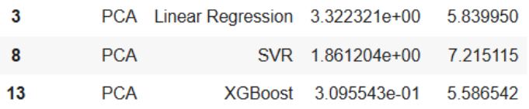
EXPERIMENT: PCA
PCA was applied to reduce features, capturing 90% of variance
Features reduced from 16 to 6 components
MSE improved for XGBoost and Linear Regression, but worsened it for SVR

Slide 14
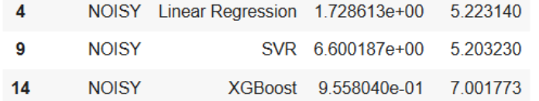
EXPERIMENT: NOISY DATA
A random continuous and categorical feature was introduced to the dataset
Linear SVR achieved the lowest MSE out of all the experiments
XGBoost started overfitting, as seen by the lowered training error but heighted testing error

Slide 15
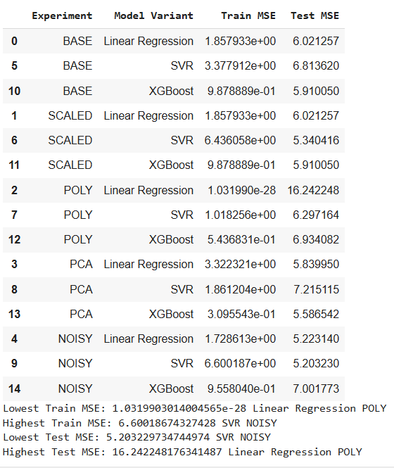
Recommended Model
SVR with a linear kernel on noisy features is the best model for this dataset
Findings imply that noisy data may reduce overfitting for linear based models, but increase overfitting in tree-based boosting models like XGBoost
Because of small dataset, overfitting is a main issue - the lowest test MSE model also had the highest train MSE
For future work, using a larger dataset (county data instead of states) may help with overfitting issues

Slide 16

THANK YOU!!!!!!!!!!!!!!!!!!!

